Slide 1

Raman Mineral Classification
A Multi-Approach Machine Learning Analysis
Author: Rohith Aryan TG M.no: m12519564
190.015 Applied Machine and Deep Learning WS25/26
Montanuniversität Leoben
January 2026

Slide 2
Introduction
Context
Raman spectroscopy enables detailed chemical analysis of minerals through spectral signature interpretation.
The Problem
Manual classification of spectral signatures is time-consuming and error-prone.
The Goal
Automate classification of 7 minerals: Albit, Calcite, Dolomit, Feldspat, Quarz, Rhodocrosite, Tile.

Slide 3
Project Objectives
Develop a Hybrid System: Compare Supervised, Unsupervised, and Classical approaches
High Accuracy: Target >95% accuracy across all classes
Scalability: Efficiently handle large datasets (1 FPS and 30 FPS)
Robustness: Ensure consistent performance regardless of sampling rate

Slide 4
Methodology Overview
Three Distinct Approaches
Supervised
Unsupervised
Classical
ResNet-18 CNN for direct image classification
Autoencoder + Random Forest for feature learning
Profile Statistics + Random Forest with handcrafted features
Global Settings: Images resized to 224×224 | SEED=42 | GPU: CUDA

Slide 5
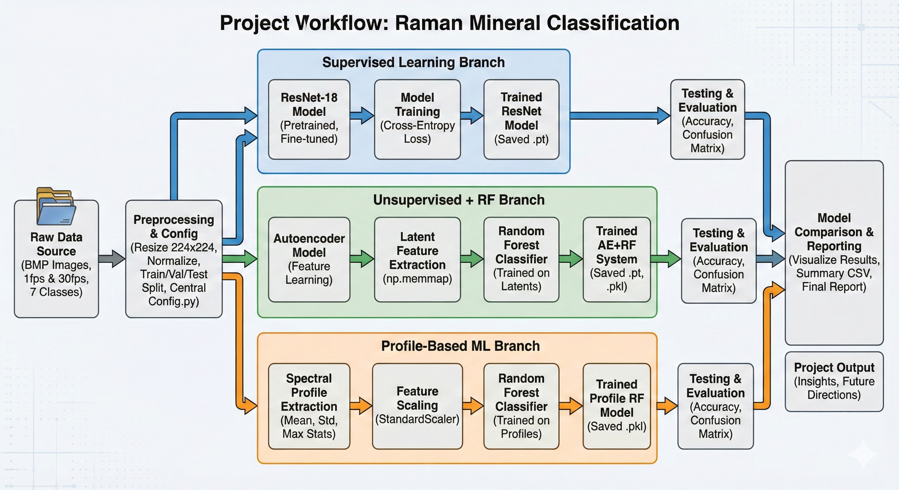
Workflow Overview

Slide 6
Method 1: Supervised Learning (ResNet-18)
Architecture
ResNet-18 pretrained on ImageNet with final layer adapted for 7 classes
Training Configuration
Cross-Entropy Loss | Fine-tuned for 5 epochs | Rapid convergence
Key Advantage
Fast convergence and high accuracy with minimal computational overhead

Slide 7
Method 2: Unsupervised (Autoencoder + RF)
Step 1: Autoencoder
Compresses images to latent vectors (dim=64) | MSE Loss minimization
Step 2: Feature Extraction
Latent features saved to disk using Memory Mapping for efficiency
Step 3: Classification
Random Forest trained on extracted latent features
Concept: Learn features without labels first, then classify

Slide 8
Method 3: Classical ML (Profile Statistics)
Data Source
Feature Engineering
Raw spectral profiles from CSV files
Statistical moments extracted: Mean, Standard Deviation, Max, Min
Pipeline
Advantages
Standardization (StandardScaler) → Random Forest (300 estimators)
Extremely fast, highly interpretable, CPU-friendly, no GPU required

Slide 9
Key Challenges & Solutions
Dataset Idealism vs. Real-World Noise:
100% accuracy suggests pure lab samples.
Model may struggle with "dirty" field data (fluorescence, low signal-to-noise).
Restricted Class Scope:
Limited to 7 specific minerals (no "Unknown" category).
Risk of false positives if an unlisted mineral is analyzed.
Lack of Mixed-Phase Detection:
Assumes single mineral per image.
Cannot quantify mixtures or those outside scope of training(e.g., rocks containing both Quartz and Feldspar).

Slide 10
Results Summary
Performance
100% Accuracy achieved on test sets across all three methods
Consistency
Identical results for both 1 FPS and 30 FPS datasets
Inference Comparison
ResNet: Fast, GPU-dependent training
Profiles RF: Fastest, CPU-friendly

Slide 11
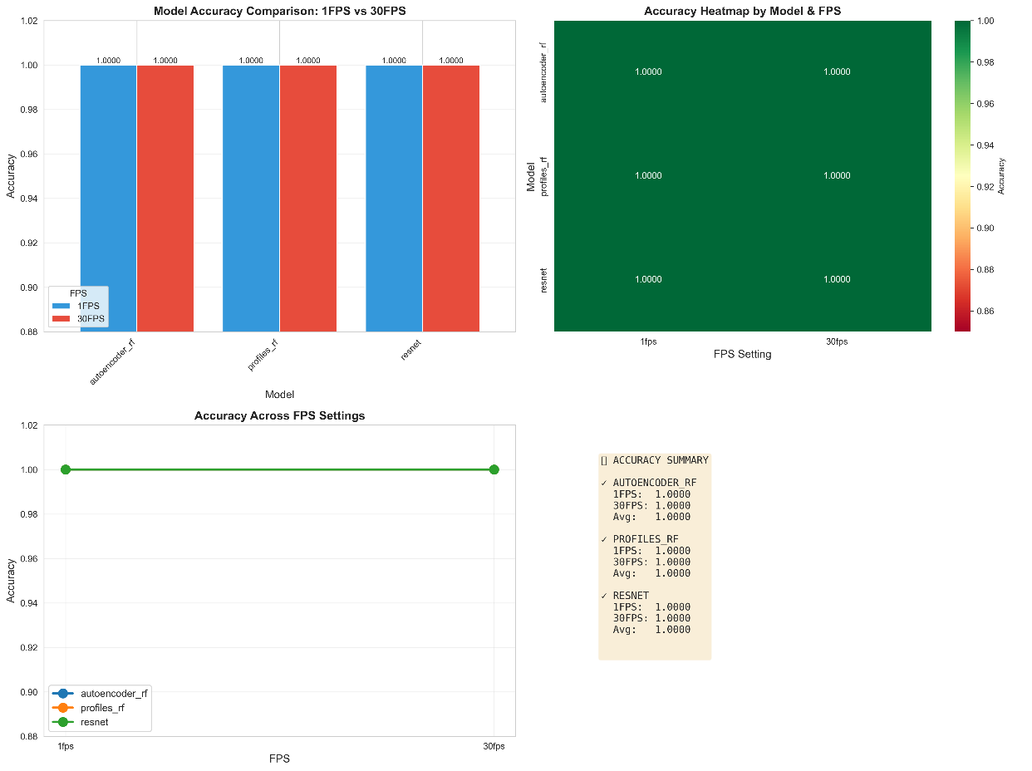
Results Visualizations
Confusion Matrices: Zero misclassifications across all 7 classes
Bar charts: Charts showing 100% accuracy across all models

Slide 12
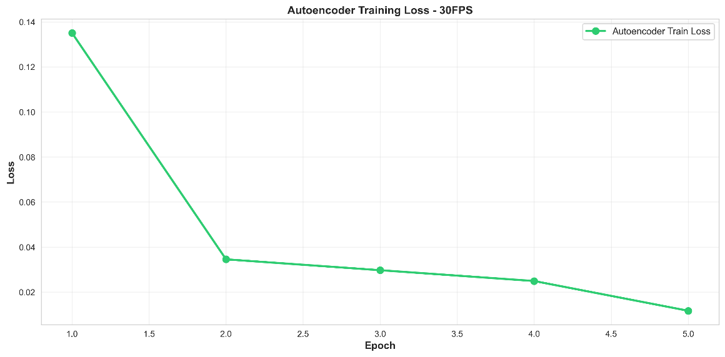
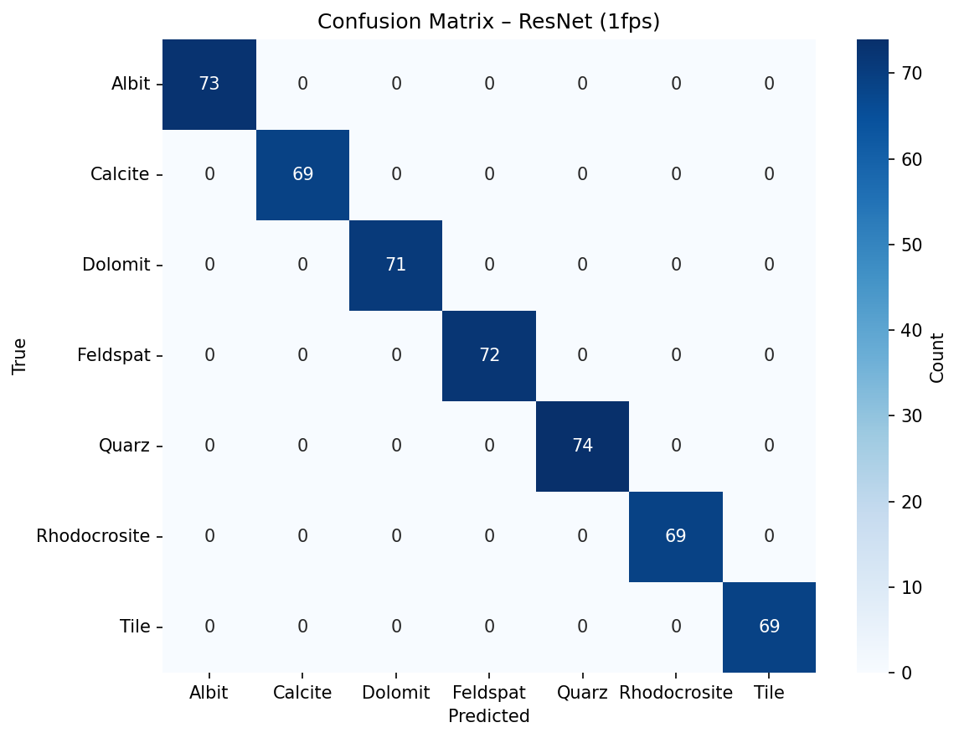
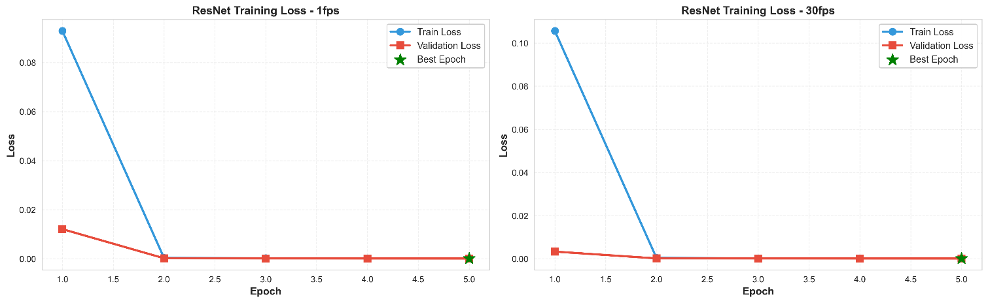
(Cont.)
Autoencoder Training Loss Curve(30 FPS)
ResNet Confusion Matrix 1 FPS
ResNet Training Loss Curve

Slide 13
Results: Tables
Table 1: ResNet-18 Training History (1 FPS)
Table 2: Autoencoder Training History (30 FPS)
Epoch | Train Loss | Val Loss | Val Acc
1 | 0.0929 | 0.0121 | 100%
2 | 0.0003 | 0.0002 | 100%
5 | 0.0001 | <0.0001 | 100%
Epoch | Train Loss | Val Loss
1 | 0.1351 | 0.0357
3 | 0.0297 | 0.0273
5 | 0.0117 | 0.0023
Table 4: Accuracy metrics across all three implemented architectures
Table 3: Profile RF Performance
Experiment | FPS | Accuracy | Test Samples
resnet | 1fps | 1 | 497
resnet | 30fps | 1 | 506
autoencoder_rf | 1fps | 1 | 497
autoencoder_rf | 30fps | 1 | 506
profiles_rf | 1fps | 1 | 13646
profiles_rf | 30fps | 1 | 14999
Dataset | Samples (Train) | Samples (Test) | Estimators | Accuracy
1 FPS | 122,810 | 13,646 | 300 | 100%
30 FPS | 134,986 | 14,999 | 300 | 100%

Slide 14
Conclusion & Acknowledgments
Key Finding
Raman spectral data for these minerals is highly distinct. Both Deep Learning and Classical methods are viable.
Limitations
High accuracy suggests ideal lab data | Limited to 7 known classes | May struggle with mixed samples
190.015 Applied Machine and Deep Learning WS25/26, Montanuniversität Leoben | Tools: PyTorch, Scikit-learn, Python 3.8+
Thank You!

